Slide 1
Roots, Fruits, Flowers & Growth You CAN Have It All
Our Water Our World
Julie Barbour
in partnership with the
City of Lincoln
&
Lincoln Hills Garden Group
Notes:
1

Slide 2
Agenda
We will go through slides for about 25 minutes,
then will leave time for questions at the end
Topics
Our Water Our World and IPM
Water
Fertilizer
Pollinators
Pesticides
Notes:
CC

Slide 3
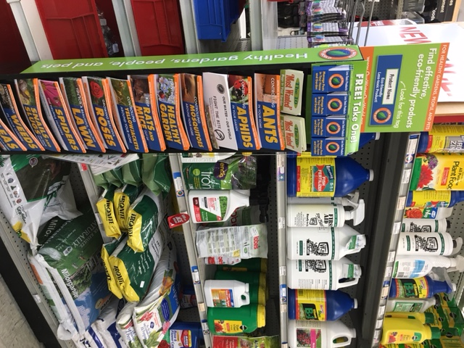
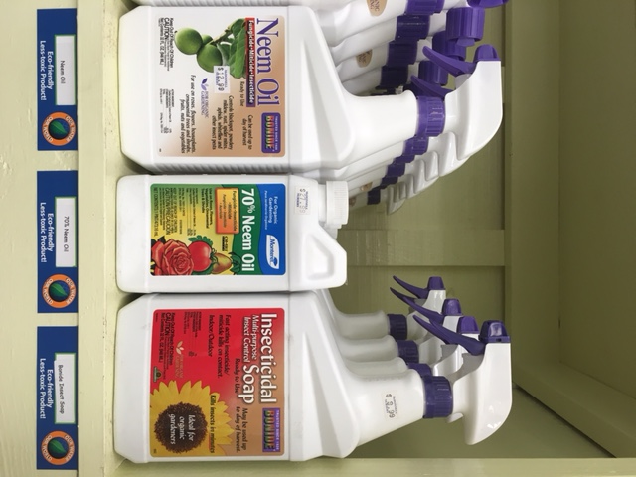
Our Water Our World
(OWOW)
National Award-Winning Program Partnership with water pollution prevention agencies & retail stores IPM Educational Program for the public
ourwaterourworld.org
Notes:
National Award-Winning Program Partnership with water pollution prevention agencies & retail stores IPM Educational Program for the public
3

Slide 4
Integrated Pest Management
A decision-making process
Science-based strategies
Looks at the system/house/garden as a whole
Ask questions:
What is the problem at hand?
Can we live with it?
Identification
Prevention
Action Steps:
Cultural Controls: bolstering the health of the garden
Mechanical Controls: traps, barriers, tools
Biological Controls: beneficial insects & supporting the ecosystem
Chemical Controls: pesticides, always a last resort
Notes:
Walk through the steps in green box.
Then in white box:
IPM is a process that focuses on identification first & foremost
Then we look at prevention,
Briefly walk explain the action steps:
Then note that:
Some pests are seasonal and expected
Pests are food for beneficials which help keep a healthy balance. We may need to reevaluate our thresholds of tolerance.
An infestation of a pest can be a clue that something is not working or that the plant is stressed. We will need to address the cause.
4

Slide 5
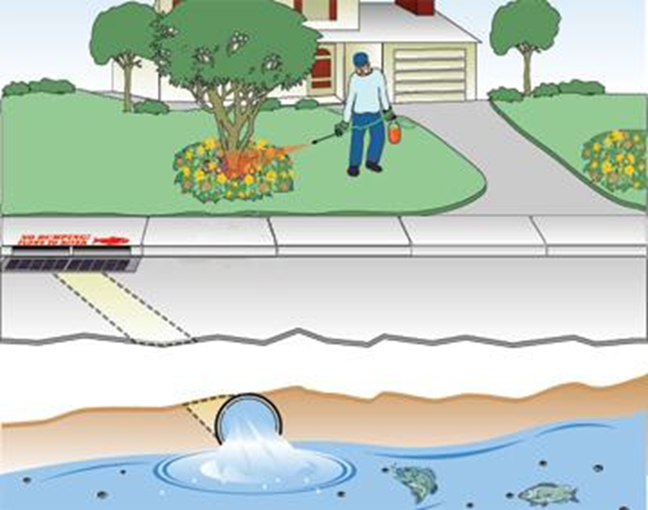
Runoff from landscapes enters the storm drains, then flows to our local waterways
Notes:
Our yards have a direct line to our local waterways.
When we do get rain, or if there is a water overflow from the irrigation system or if we are washing our car or the house, that water is call runoff and carries with it many unseen particles of toxins from the chemical pesticides & synthetic fertilizers we tend to use. These pollutants, as well as pest waste, motor oil & other litter are carried to the storm drain or nearest waterway not getting filtered.
5

Slide 6
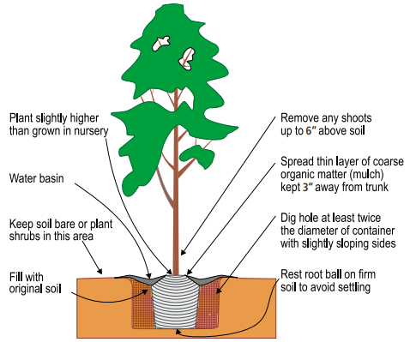
How to Plant
Planting Fruit Trees UC ANR
Notes:
Add compost.
Compost holds 5xs it’s weight in water.
You can work it into the soil at time of planting or top dress around root zones.
Compost improves your soil texture. Adds pores in clay soils, which allows roots to expand deeper & wider.

Slide 7
What Don’t You See?
Answers:
A Nursery Stake
Ties/Labels/String Digging Into the Bark
Irrigation at the Trunk
Notes:
CC

Slide 8
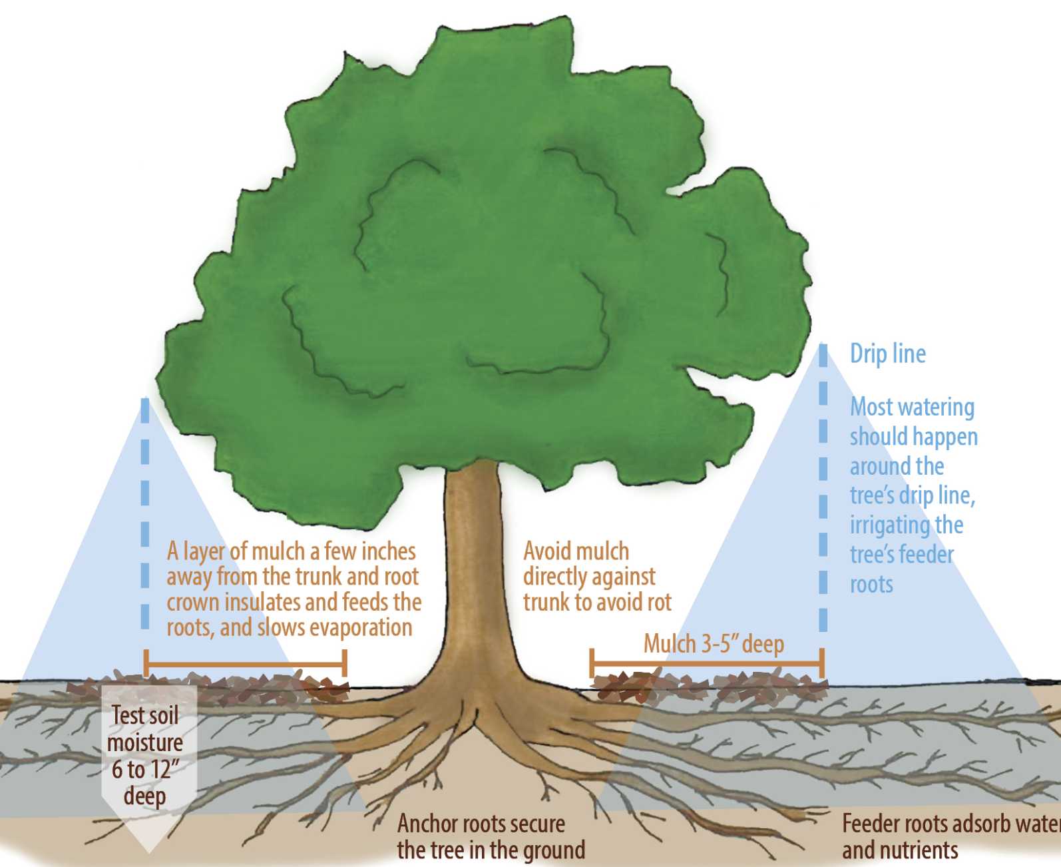
Image credit: canopy.org
Focus water at the drip line
Photo from the Vacaville Tree Foundation
Notes:
Our goal is to get that water when we water 6-12” deep on established plants. The depth depends on the plant material – perennials may only need water 6” down, whereas larger shrubs & trees may need the water to get down 12”. The water will still move beyond these depths, but for us to understand to water deeply and then don’t water again until the top 3-5” of the soil has dried out.

Slide 9
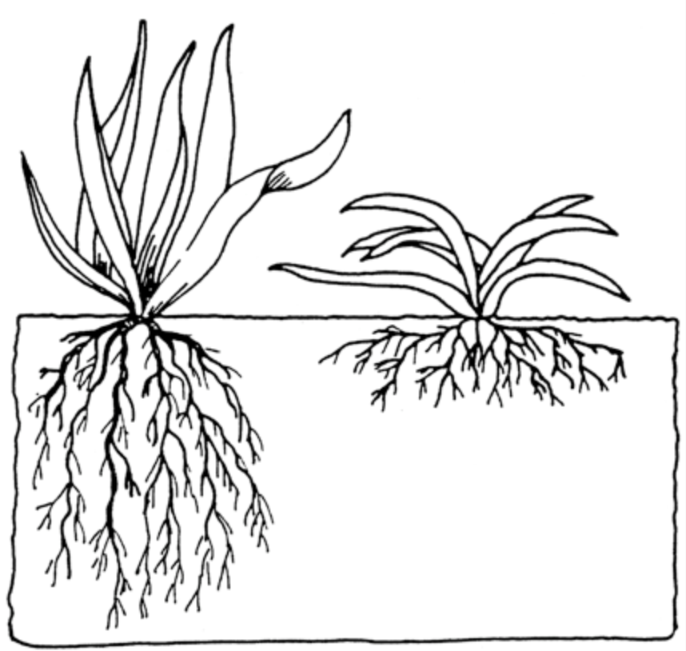
Shallow watering grows shallow roots
which dry out quickly
Water to encourage deep roots
Remember to water deeply and infrequently
NOT shallow and often
Image credit from ecomindedsolutions.com
Notes:
When we water it is important to water deeply and less often
Allow the soil to dry out between watering

Slide 10
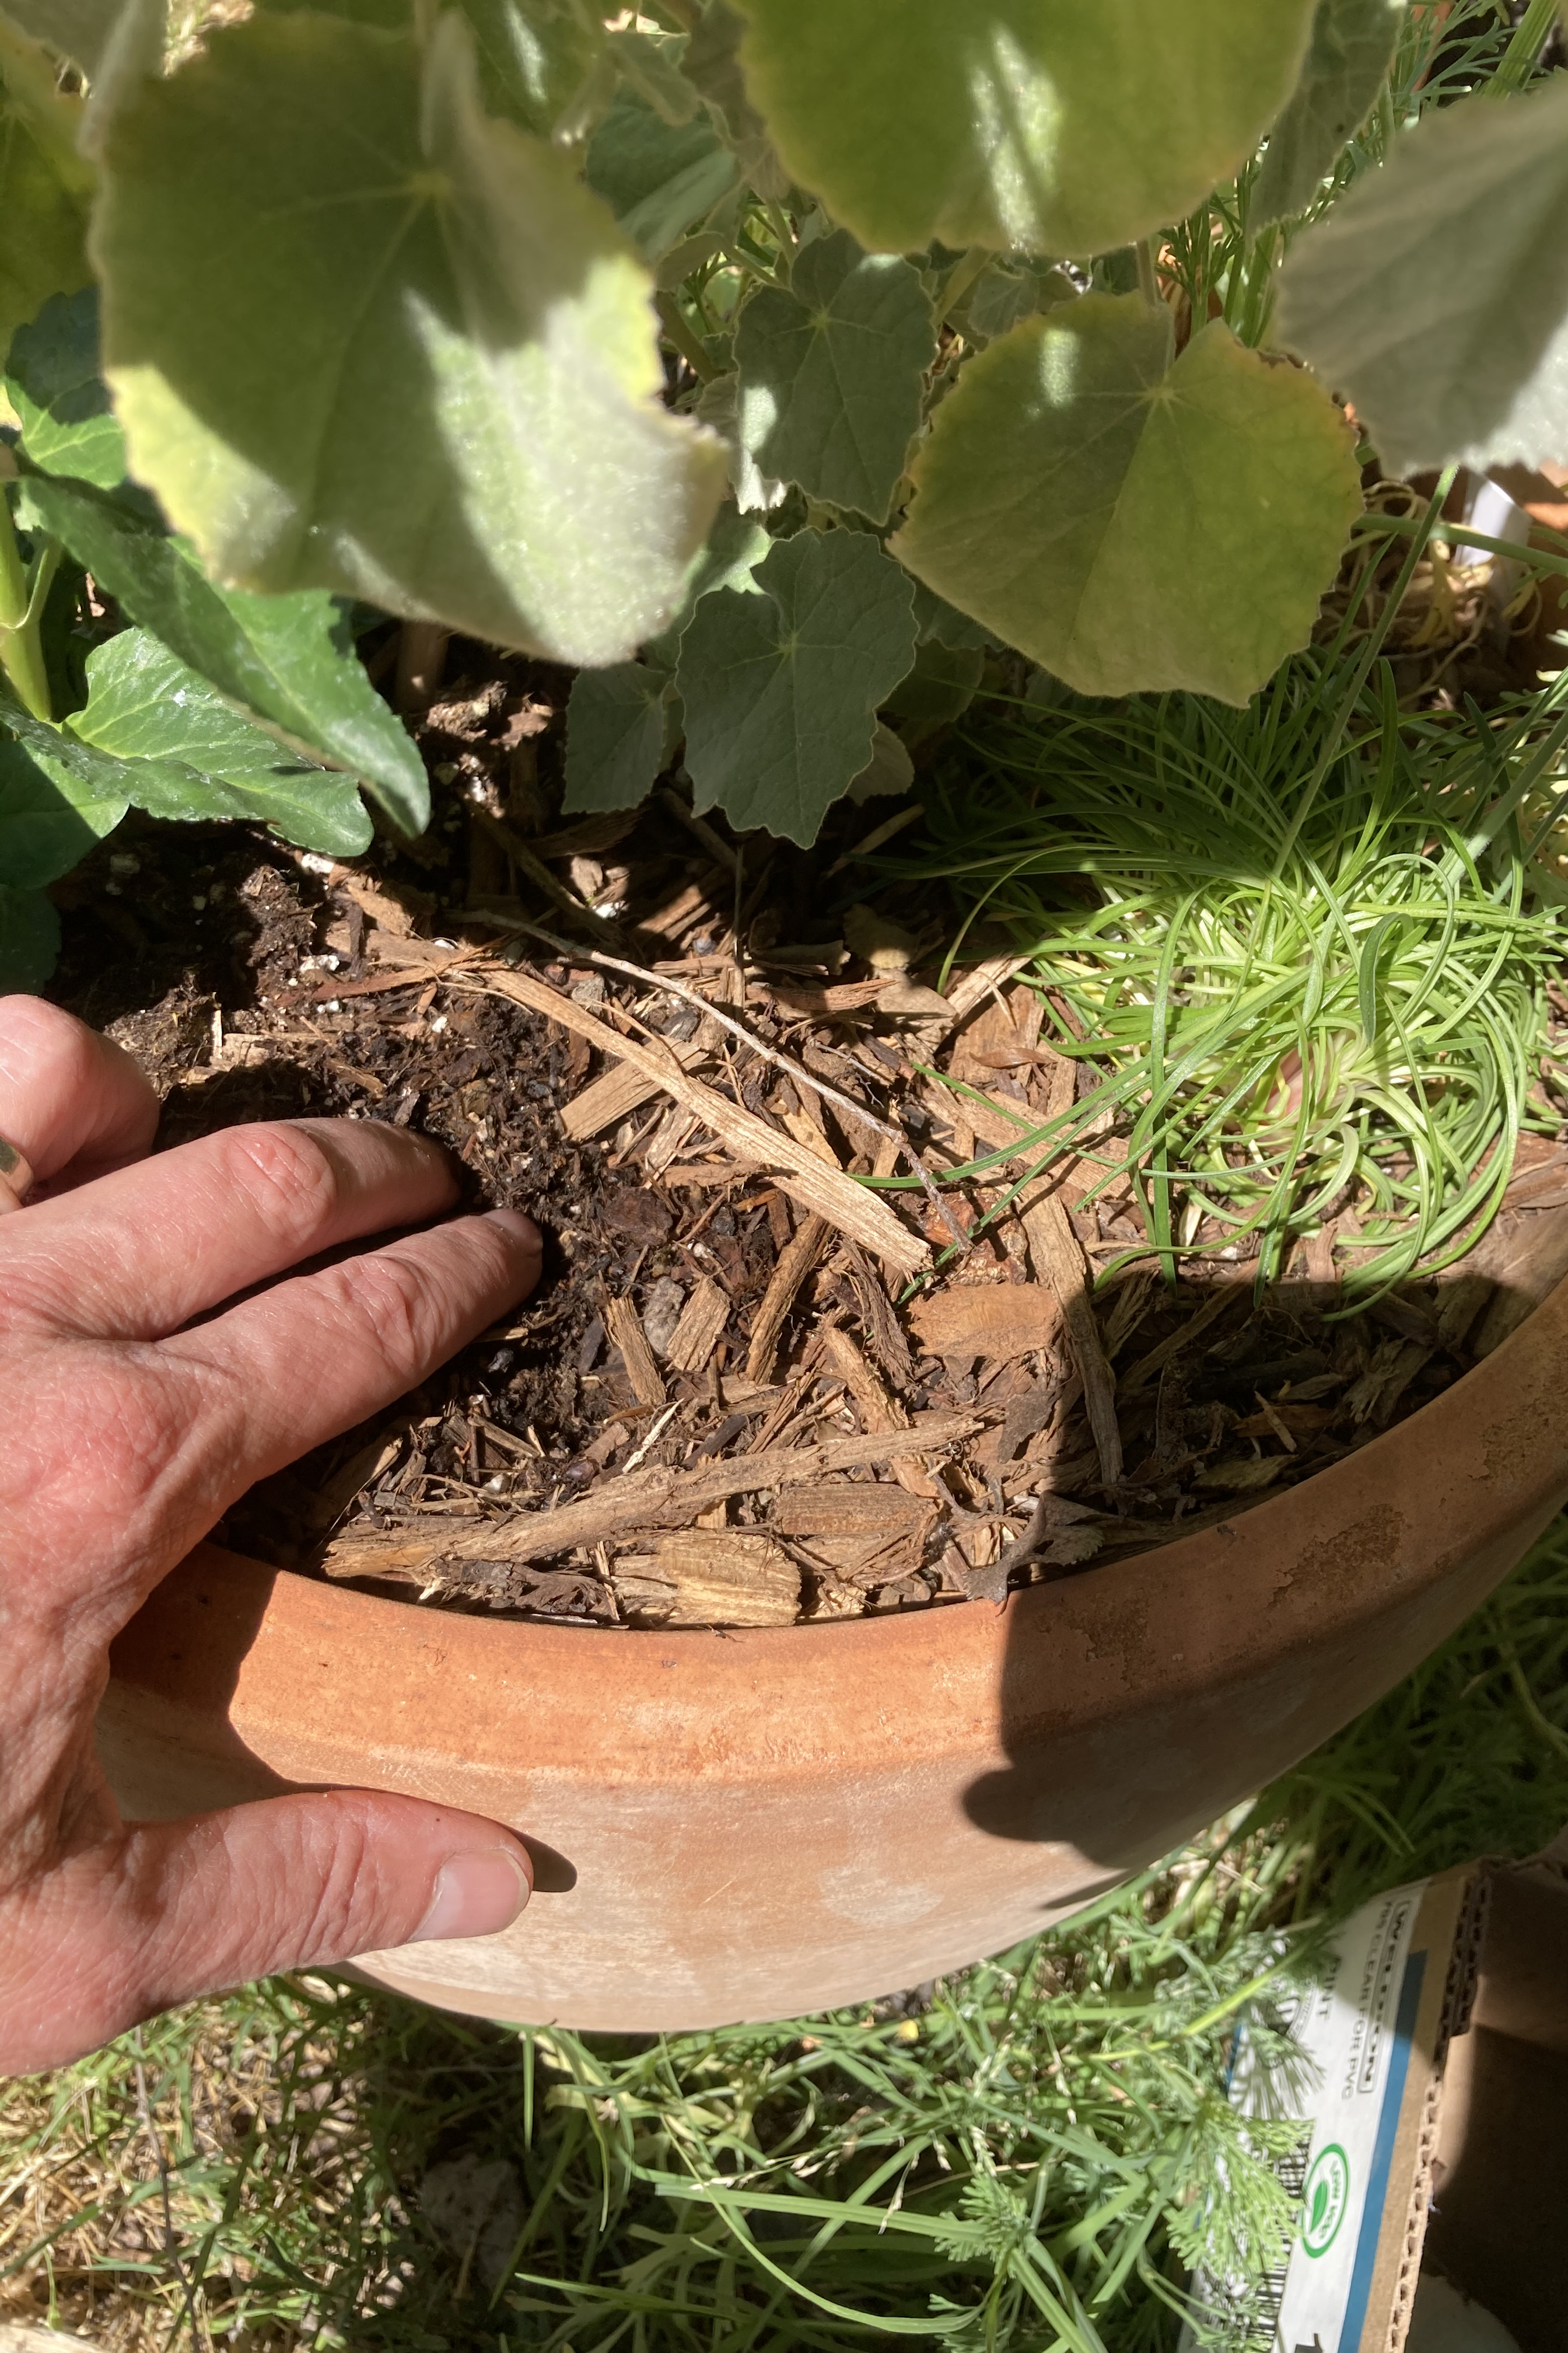
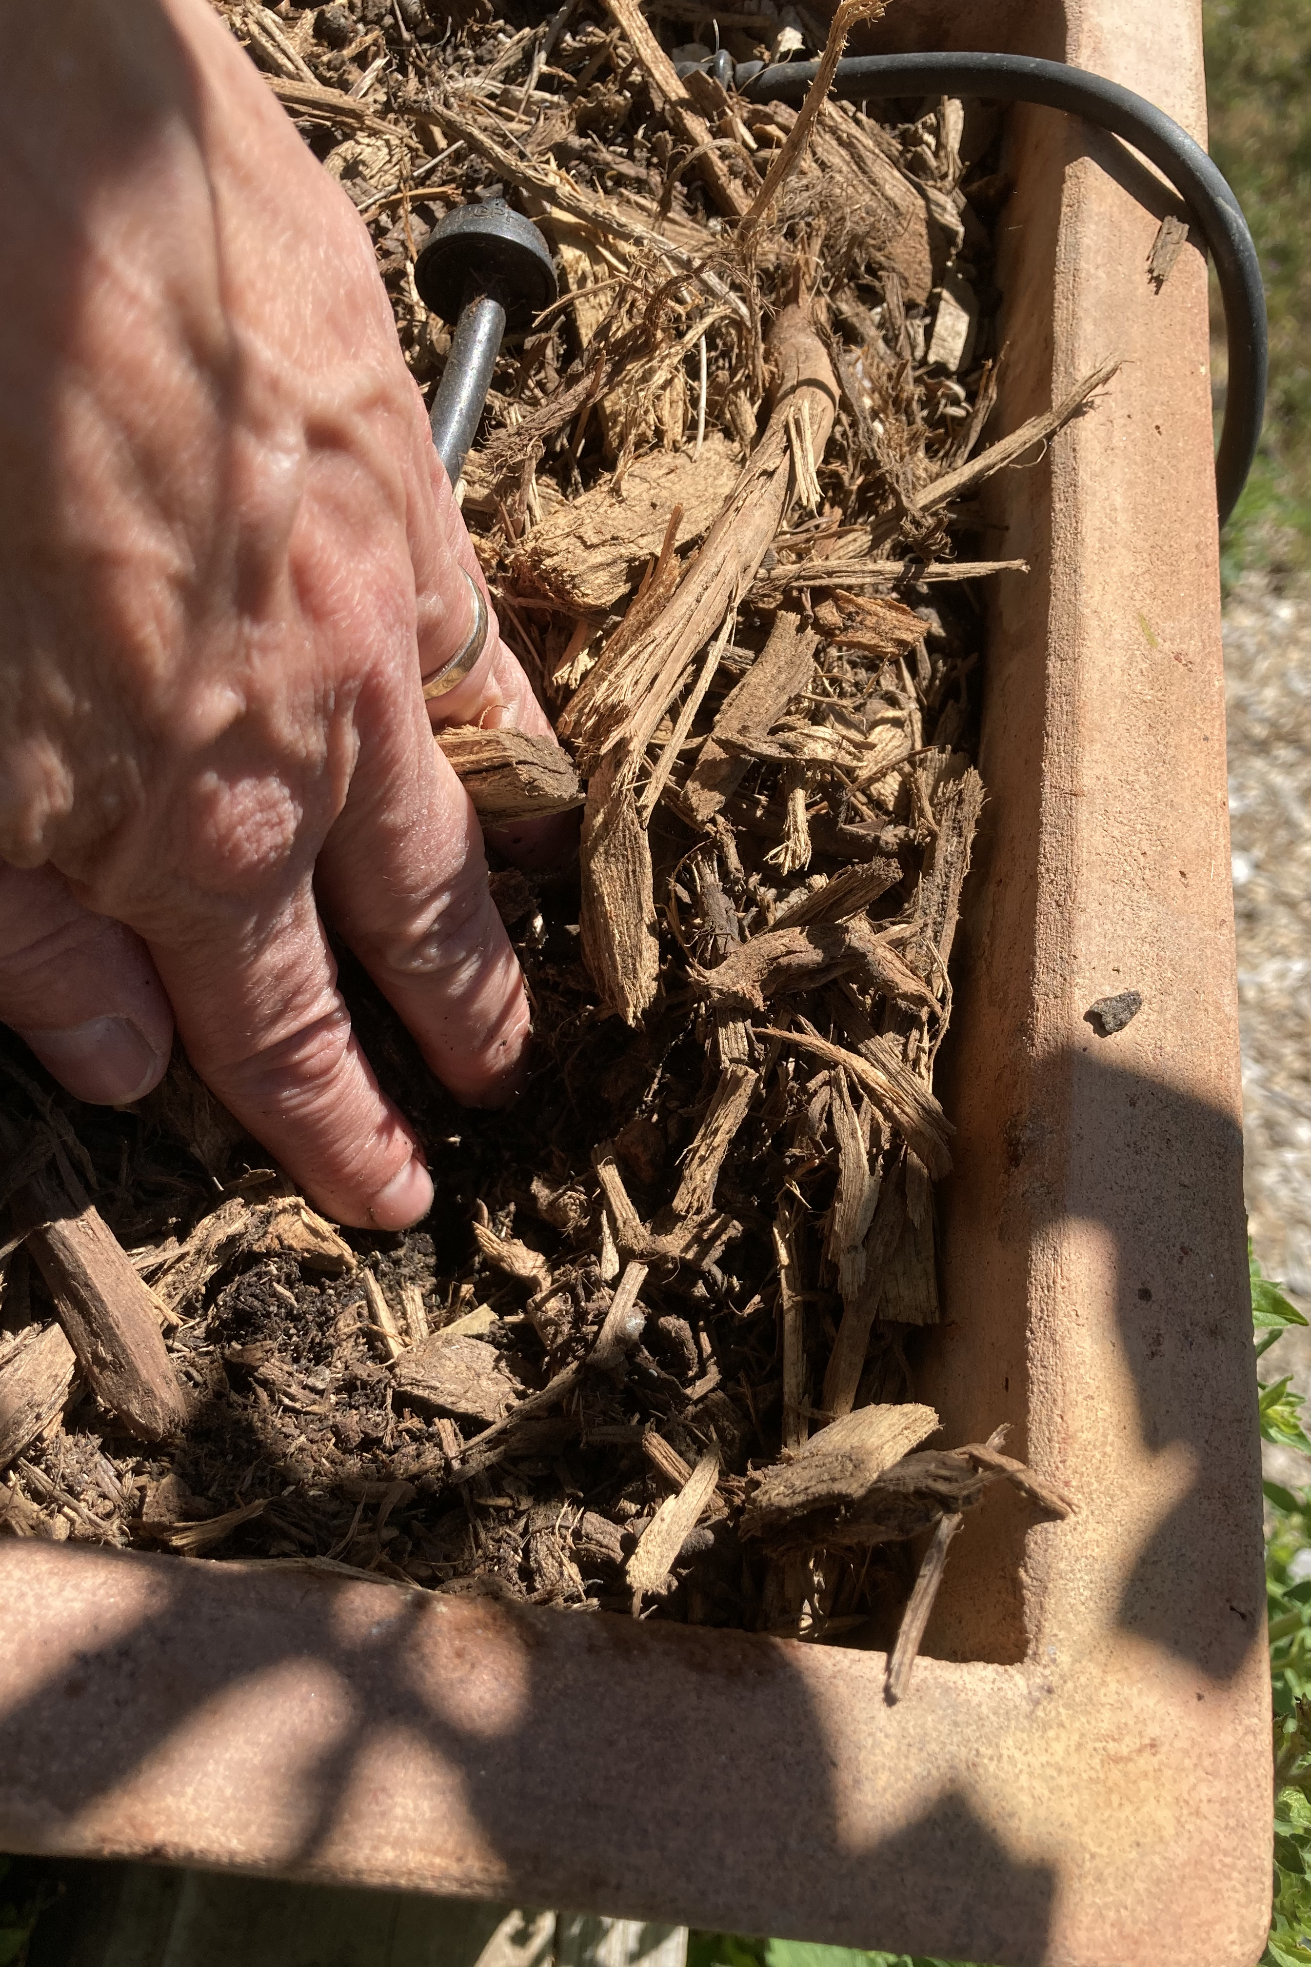
How do you know if you are overwatering or underwatering?
Photo credit: S. Bontempo
Notes:
You might think you watered well enough, but you’ll have to check. Sometimes the water doesn’t permeate down into the soil as we thought. Once you have watered, when you think the watering is complete, dig down, how far down did the water get? Some planting mediums have materials, like peat, that take some time to hydrate well. So get in the habit of checking & then you’ll know
A good tip is to water once, water other garden areas, then come back to water again. This allows the water to soak in deeper.
Dry soil is hydrophobic. If you add water too quickly it can run off Water slowly and over a longer period of time.
A layer of mulch will also protect the soil, aid with water infiltration
The top of the soil will look dry, or the top layer of much will look dry due to the sun exposure and wind. However again we need to check to see if the soil is in fact dry down a few inches.
With containers, check to see that the drainage holes are clear/not clogged
Plants can also wilt if overwatered, so check the soil
Feel it with your fingers, a moisture meter, dig down with a trowel.
10

Slide 11
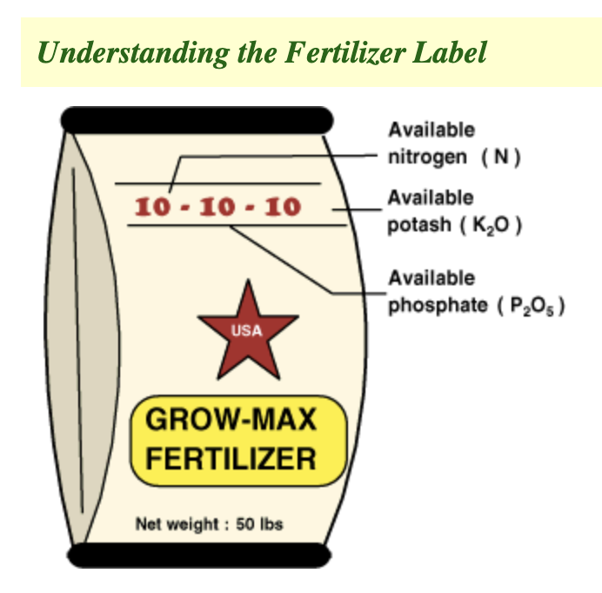
N – nitrogen P – phosphorus K - potassium

Slide 12
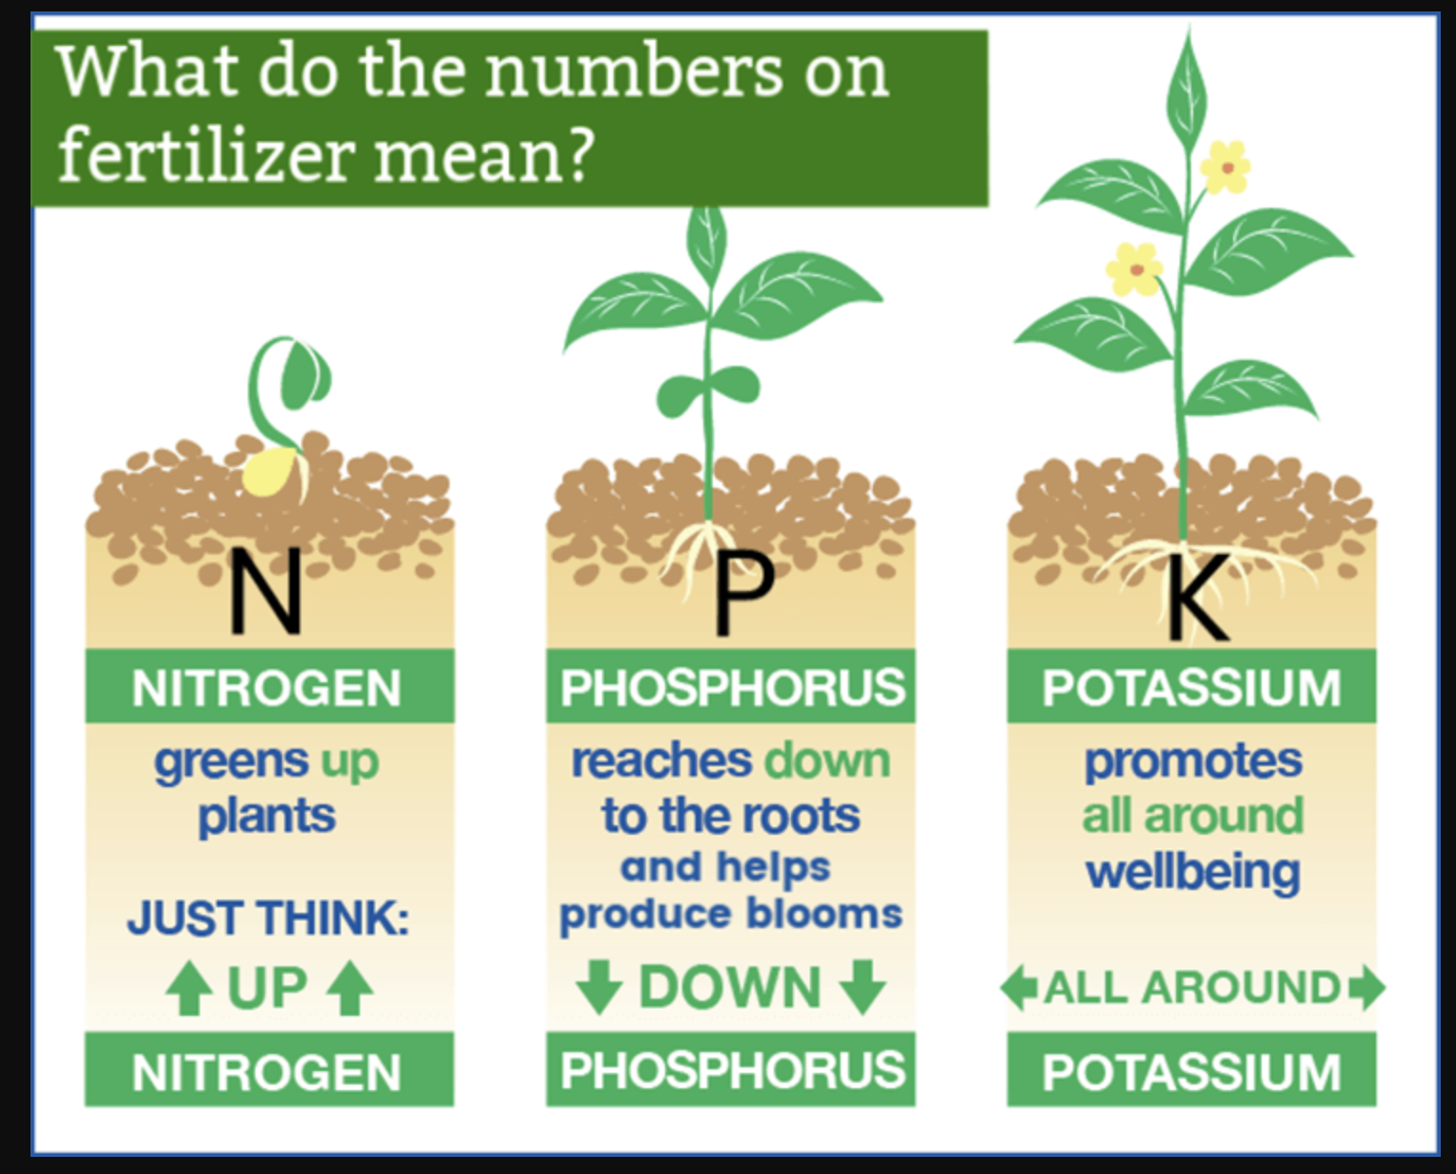
Macronutrients = Nitrogen Phosphorus Potassium Sulfur Calcium Magnesium Micronutrients = Iron Zinc Copper Manganese Boron plus more
Photo credit: worstroom.com

Slide 13
Some terms we may see

Slide 14
Organic vs Synthetic
Feeds soil microbiology
Increases soil health
Prevents grow spurts
Sustainable food for plants
Won’t run-off into local waterways
Won’t burn the plant
More economical
Natural materials from plants or animals
Renewable &/or byproducts
Feeds the plant, will need to feed more often
Stimulates new growth
Invites pests
High in salts
Can contaminate waterways
Can burn if apply too much
Manufactured products extracted by a chemical industrial process

Slide 15
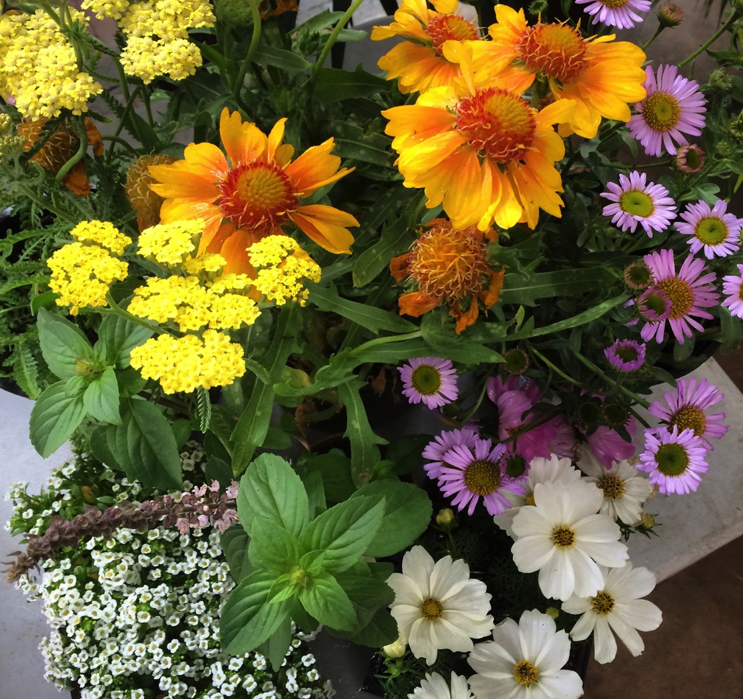
We plant a diversity of flowers that provide nectar & pollen
Photo credit: S. Bontempo
Notes:
A variety of flowering plants with a variety of Colors. Shapes, Sizes, Heights,& plant types
Bright colors. Hummingbirds prefer tubular flowers with bright colors, particularly red, yellow, and orange. Scent doesn't matter. Flowers visited by hummingbirds have mild odors or no scent at all. Hummingbirds have no sense of smell. Aim for flowers year-round. Use native plants where possible or a combination of native and non-native plants. No pesticides, please. Insects provide protein for hummingbirds, so do not use pesticides in your garden.
Start right.
Consider the soil characteristics, site drainage, sunlight, and other factors when selecting plants.
Provide a variety of flower colors and shapes to attract different pollinators.
Plant in clumps, rather than single plants, to better attract pollinators.
Choose plants that flower at different times of the year to provide nectar and pollen sources throughout the growing season.
Avoid the use of pesticides. Practice Integrated Pest Management (IPM) to reduce damage to your plants and to protect pollinators by using less chemicals.
Visit a plant nursery to ask about pollinator plants suited for your site conditions.
Support growers that do not treat their nursery stock with harmful pesticides.
15

Slide 16
Flowers that look like a daisy or a sunflower:
Erigeron Cosmos Aster
Gaillardia Rudbeckia Coreopsis
Echinacea Helenium Calendula
Flowers that grow in clusters of tiny flowers:
Yarrow Ceanothus Agastache
Alyssum Lavender Mint
Eriogonum Oregano Parsley
Small & Large tubular flowers:
Salvias Buddleia Fuchsias
Abutilons Agastache Nicotiana
Trumpet vine Pink Jasmine Grevillea
Nepeta Bachelor Buttons Bee Balm
Lobelia Lupine Bleeding Hearts
Zinnias Columbine Petunias
Scabiosa Verbena Lantana
Notes:
Bees:
Large swaths of one single plant type are most attractive to bees for ease of foraging. Provide pollen AND nectar. Plant flowers that provide BOTH pollen and nectar for bees. Plant a continuously blooming garden. Select flowers that will provide successive blooms in spring, summer, and fall. Variety attracts diversity. Choose ten or more bee attractive flower species for a diversity of bee visitors. They love sunlight. Bees prefer to visit flowers in the sun. Leave some ground bare. The majority of bees nest in the ground, so leave areas of your garden bare of mulch or weed cloth. Please, no chemicals. Avoid plants treated with neonicotinoids. Do not use broad-spectrum pesticides.
Hummingbirds:
Bright colors. Hummingbirds prefer tubular flowers with bright colors, particularly red, yellow, and orange. Scent doesn't matter. Flowers visited by hummingbirds have mild odors or no scent at all. Hummingbirds have no sense of smell. Aim for flowers year-round. Use native plants where possible or a combination of native and non-native plants. No pesticides, please. Insects provide protein for hummingbirds, so do not use pesticides in your garden. Nectar is sugar water. You can make your own—mix ¼ cup of sugar to one cup of water. Remember to keep your hummingbird feeder filled.
16

Slide 17
Pesticides
What to Choose and When
Target the problem and only the problem
Choose less toxic - OWOW and NPIC
Avoid broad spectrum and systemics
Organic whenever possible - OMRI or USDA
Only spray outdoors after sunset
Notes:
CC

Slide 18
Pesticides
How to Use
Read & Follow The Label
Do Not Exceed The Limit (# of times, ratios)
Is it for use on that pest?
Prevention or cure?
Life stage of pest (egg, larval or adult)
Weeds
What, where, when
Notes:
CC

Slide 19
Pesticides
Storing & Disposal
Store in cool, dark well-ventilated areas
Away from pets, kids, food, etc.
Follow manufacturer’s instructions
Dispose of properly – Never in trash or down the drain
Label directions for disposal may not be legal
Notes:
CC

Slide 20
Red Flags
Active Ingredients? Can you pronounce them?
Does it kill 100’s of insects?
Does it work for 6 weeks, 6 months or a year?
EPA signal words: Caution Warning Danger
PPE and PHI and First Aid
Labels tell you what pests it kills. It does NOT tell you what beneficials it also kills.
Notes:
CC

Slide 21
Let’s finish with your questions…
Thank you for Joining!
Our Water Our World
ourwaterourworld.org
In Partnership with
City of Lincoln
&
Lincoln Hills Garden Group
https://lincolnstormwater.org/ask-the-expert/
Notes:
21

